Slide 1
Feisal Farah
PhD Candidate
Hull University and Wilberforce Institute

Slide 2
The Evolution of Political Salafism: Al-Shabaab and Islamic Networks on the Coast of Kenya
The Evolution of Political Salafism: Al-Shabaab and Islamic Networks on the Coast of Kenya

Slide 3
Abstract
This study will discuss the connection between Political Salafism and Al-Shabaab on the coast of Kenya.
People on the coast of Kenya and the Muslim population in particular have suffered from political and economic marginalization during and after colonialism.
The study focuses on the evolution of political Salafism and the changing landscape of Islam on the coast of Kenya.

Slide 4
Abstract 2
By the 1990s, disaffected Muslim youths were flocking to the radical Muslims preachers, who were able to radicalize and mobilize them.
When al-Shabaab showed up a decade or two later there was a ready pool of potential recruits among Kenya’s disgruntled Muslim youths.
The study plans to show that the city of Mombasa and the other coastal towns were already a fertile ground for recruitment into a jihadi movement.

Slide 5
Abstract 3
I will show that al-Shabaab was able to take advantage of the existing social grievance amongst Kenya’s disadvantaged Muslim populations on the coast. Salafi Imams were not left out either.
They were able not only to give moral support to al-Shabaab, but also funneled recruits and financial help to al-Shabaab.

Slide 6
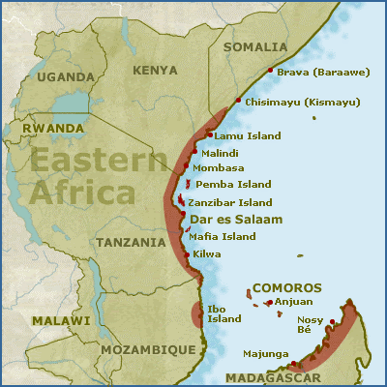
Map of the Swahili Coast

Slide 7
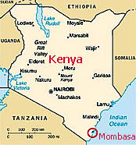
Map of Kenya

Slide 8
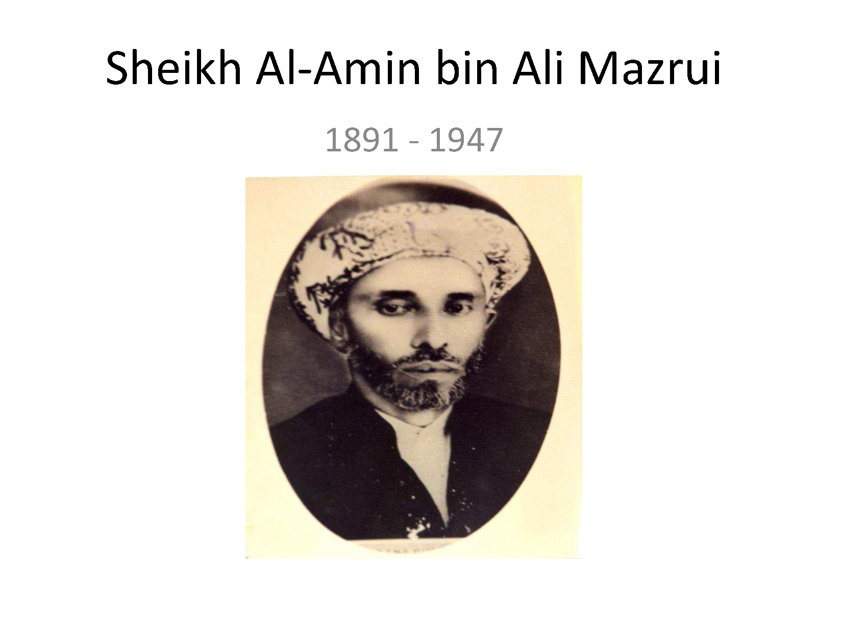
Sheikh Al-Amin Ali Mazrui (1891–1947)

Slide 9
Sheikh Al-Amin Ali Mazrui Page 2
Islamic Reformist
Challenged local Islamic practices on the coast of Kenya
He published weekly newsletters circulated in Mombasa in the 1920s and 1930s

Slide 10
Sheikh Al-Amin Ali Mazrui Page 3
He encouraged the Muslims to send their children to colonial schools.
Scholars Like Kai Kresse argues that Sheikh Mazrui was a “modernist” felt Islam was compatible to modern science and secular education (Chome, 2019, p. 7-8).

Slide 11
Sheikh Al-Amin Ali Mazrui Page 4
Sheikh Mazrui was a member of Mombasa’s established Arab upper class, all of whom were designated as non-natives during the colonial period and therefore not subject to British colonial precepts of control and whom had traditionally avoided marriages with non-Arab families.

Slide 12
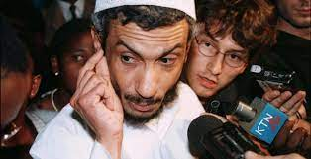
Sheikh Khalid Balala

Slide 13
Sheikh Khalid Balala 2
The 1990s was known as ‘The Second Liberation’ a decade of political turbulence, where ‘disparate political’ groups united in their opposition to the repressive regime of Daniel Arap Moi (Bakari, 2013, p. 16).
At the end of 1991 President Moi’s government allowed for multiparty participation in the election.
At the end of 1991, a group of Muslims led by Omar Mwinyi and Abdulrahman Wandati tried to register the Islamic Party of Kenya (IPK) (Oded, 1996, p. 407).

Slide 14
Sheikh Khalid Balala 3
The Party seemed to particularly galvanize the Muslim in Mombasa and the coast of Kenya (Oded, 1996, p. 407).
The demands by the IPK to stop the marginalization of Muslims in education, government employment, and the media (Oded, 1996, p. 407).
The IPK was successfully in rallying young Muslims to their cause and many believed that the Party could force the government to stop treating Muslims as ‘second class citizens’ (Oded, 1996, p. 407).

Slide 15
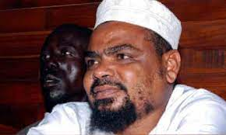
Sheikh Aboud Rogo Mohamed (1968–2012)
Notes:
2002 Rogo was accused and charged with being involved in the bombing of the Paradise Hotel in Kikambala near Mombasa, with other al-Qaeda members but let go 3 years later for lack of evidence.
2010 he was arrested and charged with a bombing of a Uganda bound bus in the Nairobi.

