Slide 1
Governing Pious Mujāhidīn: Jihadi Governance by Lake Chad
Alessio Iocchi
(Università Orientale di Napoli
& Norwegian Institute of International Affairs)
aiocchi@unior.it // alessioi@nupi.no

Slide 2
Empirical findings
Empirically, the research on which this presentation is based shows the development by ISWAP of governing techniques and devices as well as the importance of the interaction between combatant and civilian population in ISWAP-administered areas between 2016 and 2021

Slide 3
Methodological approach
Methodologically, the research on which the presentation is based draws on the actor-network theory (Deleuze & Guattari 1980; Latour 2005), which stresses the primacy of nodes and connections, thus recognizing the inherent thread-like nature of contemporary societies.
Furthermore, the article draws equally from the the dialectic of the “trans-local entanglement” (Freitag & von Oppen 2010) which, arguing for the study of globalisation(s) from a Southern perspective, unveils the existence of several layers of interaction through specific nodes that go beyond nation-state logics

Slide 4
Theoretical argument
Theoretically, the research argues two main points.
First, that ISWAP did develop, structure and enforce governing techniques adapted to the Lake Chad context, moulded to match the particular geographical and human context: an highly-mobile «roaming governance» (Iocchi 2020; 2021).
Secondly, that ISWAP did develop such governance devices also as a consequence of doctrinal debates, scholarly disputes and intellectual arguments that were equally drawn from the broader jihadi-Salafi debate and from the more Syrian-context specific intra-IS debate on takfīr (excommunication) (Iocchi & Brigaglia 2020).

Slide 5
Sources
(Mostly) ethnographic fieldwork: Yobe State (Nigeria), nov. 2014; Bol et Baga Sola (Tchad), nov. 2016 - fev. 2017; Diffa, Nguigmi (Niger), ott.-dec. 2018; Diffa (Niger), ott. 2021
Combatant-produced documents and propaganda and cultural items
US diplomatic cables
Selected interviews with key informers (Nigeria, Tchad, Niger)

Slide 6
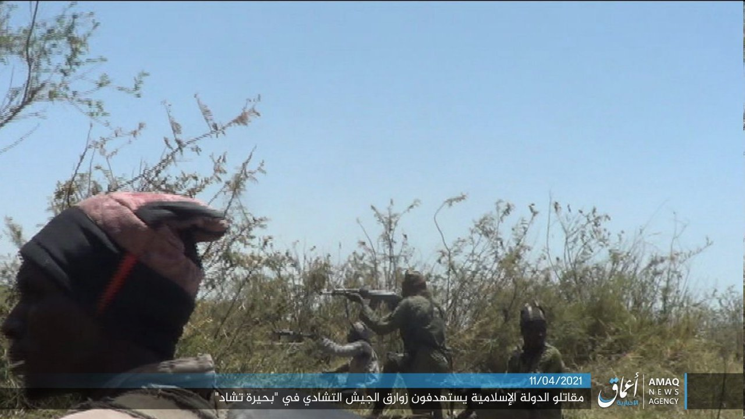
Relationship between Mamman Nur and Abubakar Shekau (2005-2018)
Issue of takfir—and specifically takfir musalsal (serial takfir)
August 2016: Nur issues and “Exposé” of Shekau audio file, invites combatants to perform Hijra, leave Shekau
Nur questions Shekau regarding the usage of ghanima (spoils of war)
Under the lenses of an ‘aqīda discourse, a misplaced tawallī becomes comparable to an act of širk (polytheist worship)

Slide 7
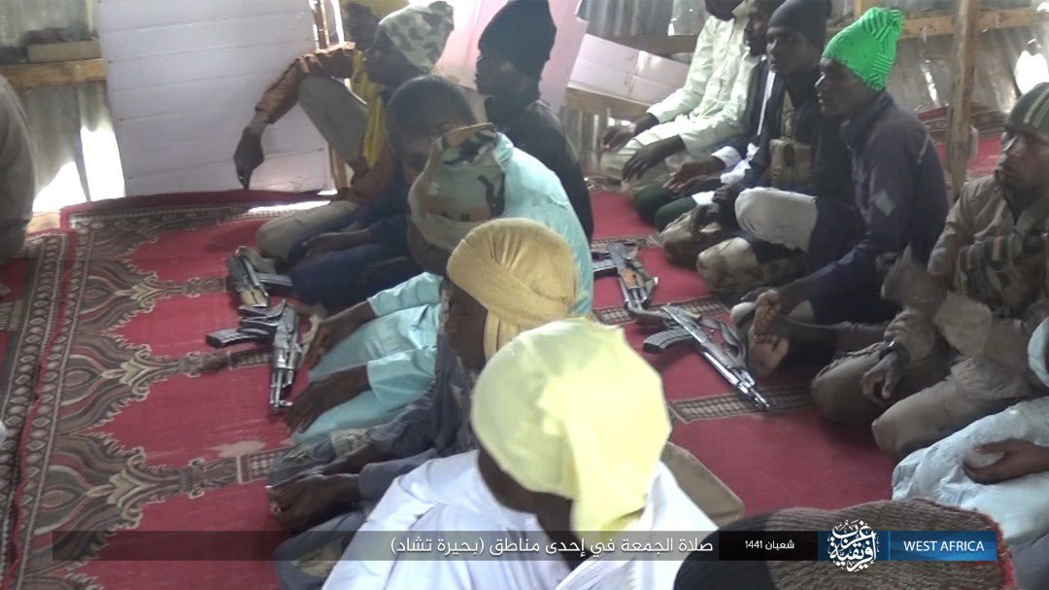
The “Dawla issue” (2014-5), i.e. the gradual repositioning of allegiances and alliances in the wake of the declaration of the Caliphate in Syria
Episodes of tensions
Split —> emergence of ISWAP
Aḥmad b. ‘Umar al-Ḥāzimī —> takfir al-‘adir (excommunication of the excuser)
Bin Ali —> dār al-kufr al-ṭāri’ (lapsed abode of unbelief) [to accomodate the position of Muslims living in non-sharia-ruled lands)
Hazimi current within IS: ġuluww (extremists) or not? Pendularity of the IS’ military and intellectual leadership response
The decision-making processes of IS are influenced more by the pressure of al-ġulāt than by the advice of the scholars. The increased relevance of the “extremists” and its disruptive potential are not neutralized

Slide 8
The “Dapchi issue” (feb. 2018), i.e. the kidnapping of 110 schoolgirls from an all-female secondary school in Dapchi (Yobe State), reflects the dynamic presented in the previous slide
Decison-makers tend to follow the advice of al-ġulāt also in local wilaya
The theological/strategic rift between Nur and Shekau in the Wilāya, reflected the same dynamic of the rift between “Bin‘alīs” and “Ḥāzimīs” in the Caliphate.

Slide 9
al-Baġdādī’s Caliphate had tried to build its legitimacy and authority within the jihadist landscape vis- à-vis other, theologically more accommodating organizations like al-Qā‘ida, on an “ultra-purist” reading of the borders between faith (īmān) and unbelief (kufr)
Unable to propose (or to impose) a coherent and stable takfīr doctrine while controlling its potentially disruptive effects, the scholarly leadership has been marginalized by the rise to leadership positions of a battleground-forged generation of mujahidin
Conclusions (1)

Slide 10
More takfir tends to produce a more asser- tive leadership and more motivated militants. However, it carries with it a set of potential risks, for it can either (1) multiply the number of potential targets ad infinitum, leading the movement to a strategic isolation (as has been the case with Shekau’s AS-DJ), or (2) increase the internal instability of the group, by exposing every new generation of leaders to the risk of becoming the object of a new takfīr by emerging commanders (as has been the case with IS-WAP)
Conclusions (2)

Slide 11
Conclusions (3)
The governing device developed by takfir-constrained movements like ISWAP needs to be continuously accommodated between the material needs of the combatant base (on issue like ghanima) and the severe limitations posed by the takfiri-minded political decisions (see also Foucher 2021)

