Slide 1
Memories, identities, and politics in Guéra’s community conflicts. An approach to stability and cohesion in Sahel from the microlevel
Valerio Colosio

Slide 2
Community conflicts in Guéra
What are the roots of conflict in Guéra?
Are existing divisions a legacy of the past or the consequences of more recent policies?
Moving from my focus on local dynamics mainly related to slave raids, I try to connect them with broader issues affecting contemporary Sahel
Guéra nowadays has no active insurrections, but like many Chadian regions a wide array of local issues. What are causes and potential consequences of this?

Slide 3
Methods
Nine months fieldwork (September 2014 to June 2015) and various short visits afterwards (2016, 2020, 2022)
Collection of local stories from 27 villages in the department of Mongo with groups of 4 – 8 elders telling the stories of the village
Triangulation between the stories and with the available colonial documents
The purpose was not to find understand the history, but to compare the ways memories are built in the Guéra
There is a relevant body of literature of the “north-south” divide or the critical location of Chad. Exploring micro-divisions in a religiously quite homogenous region could bring new evidence

Slide 4
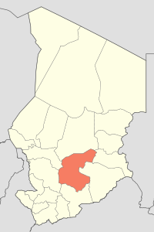
The province of Guéra
Guéra is a mountainous area in the central part of Chad. My research mainly focused on the department of Guéra, at that time composed of 6 cantons (nowadays 8) representing different groups of herders and farmers

Slide 5
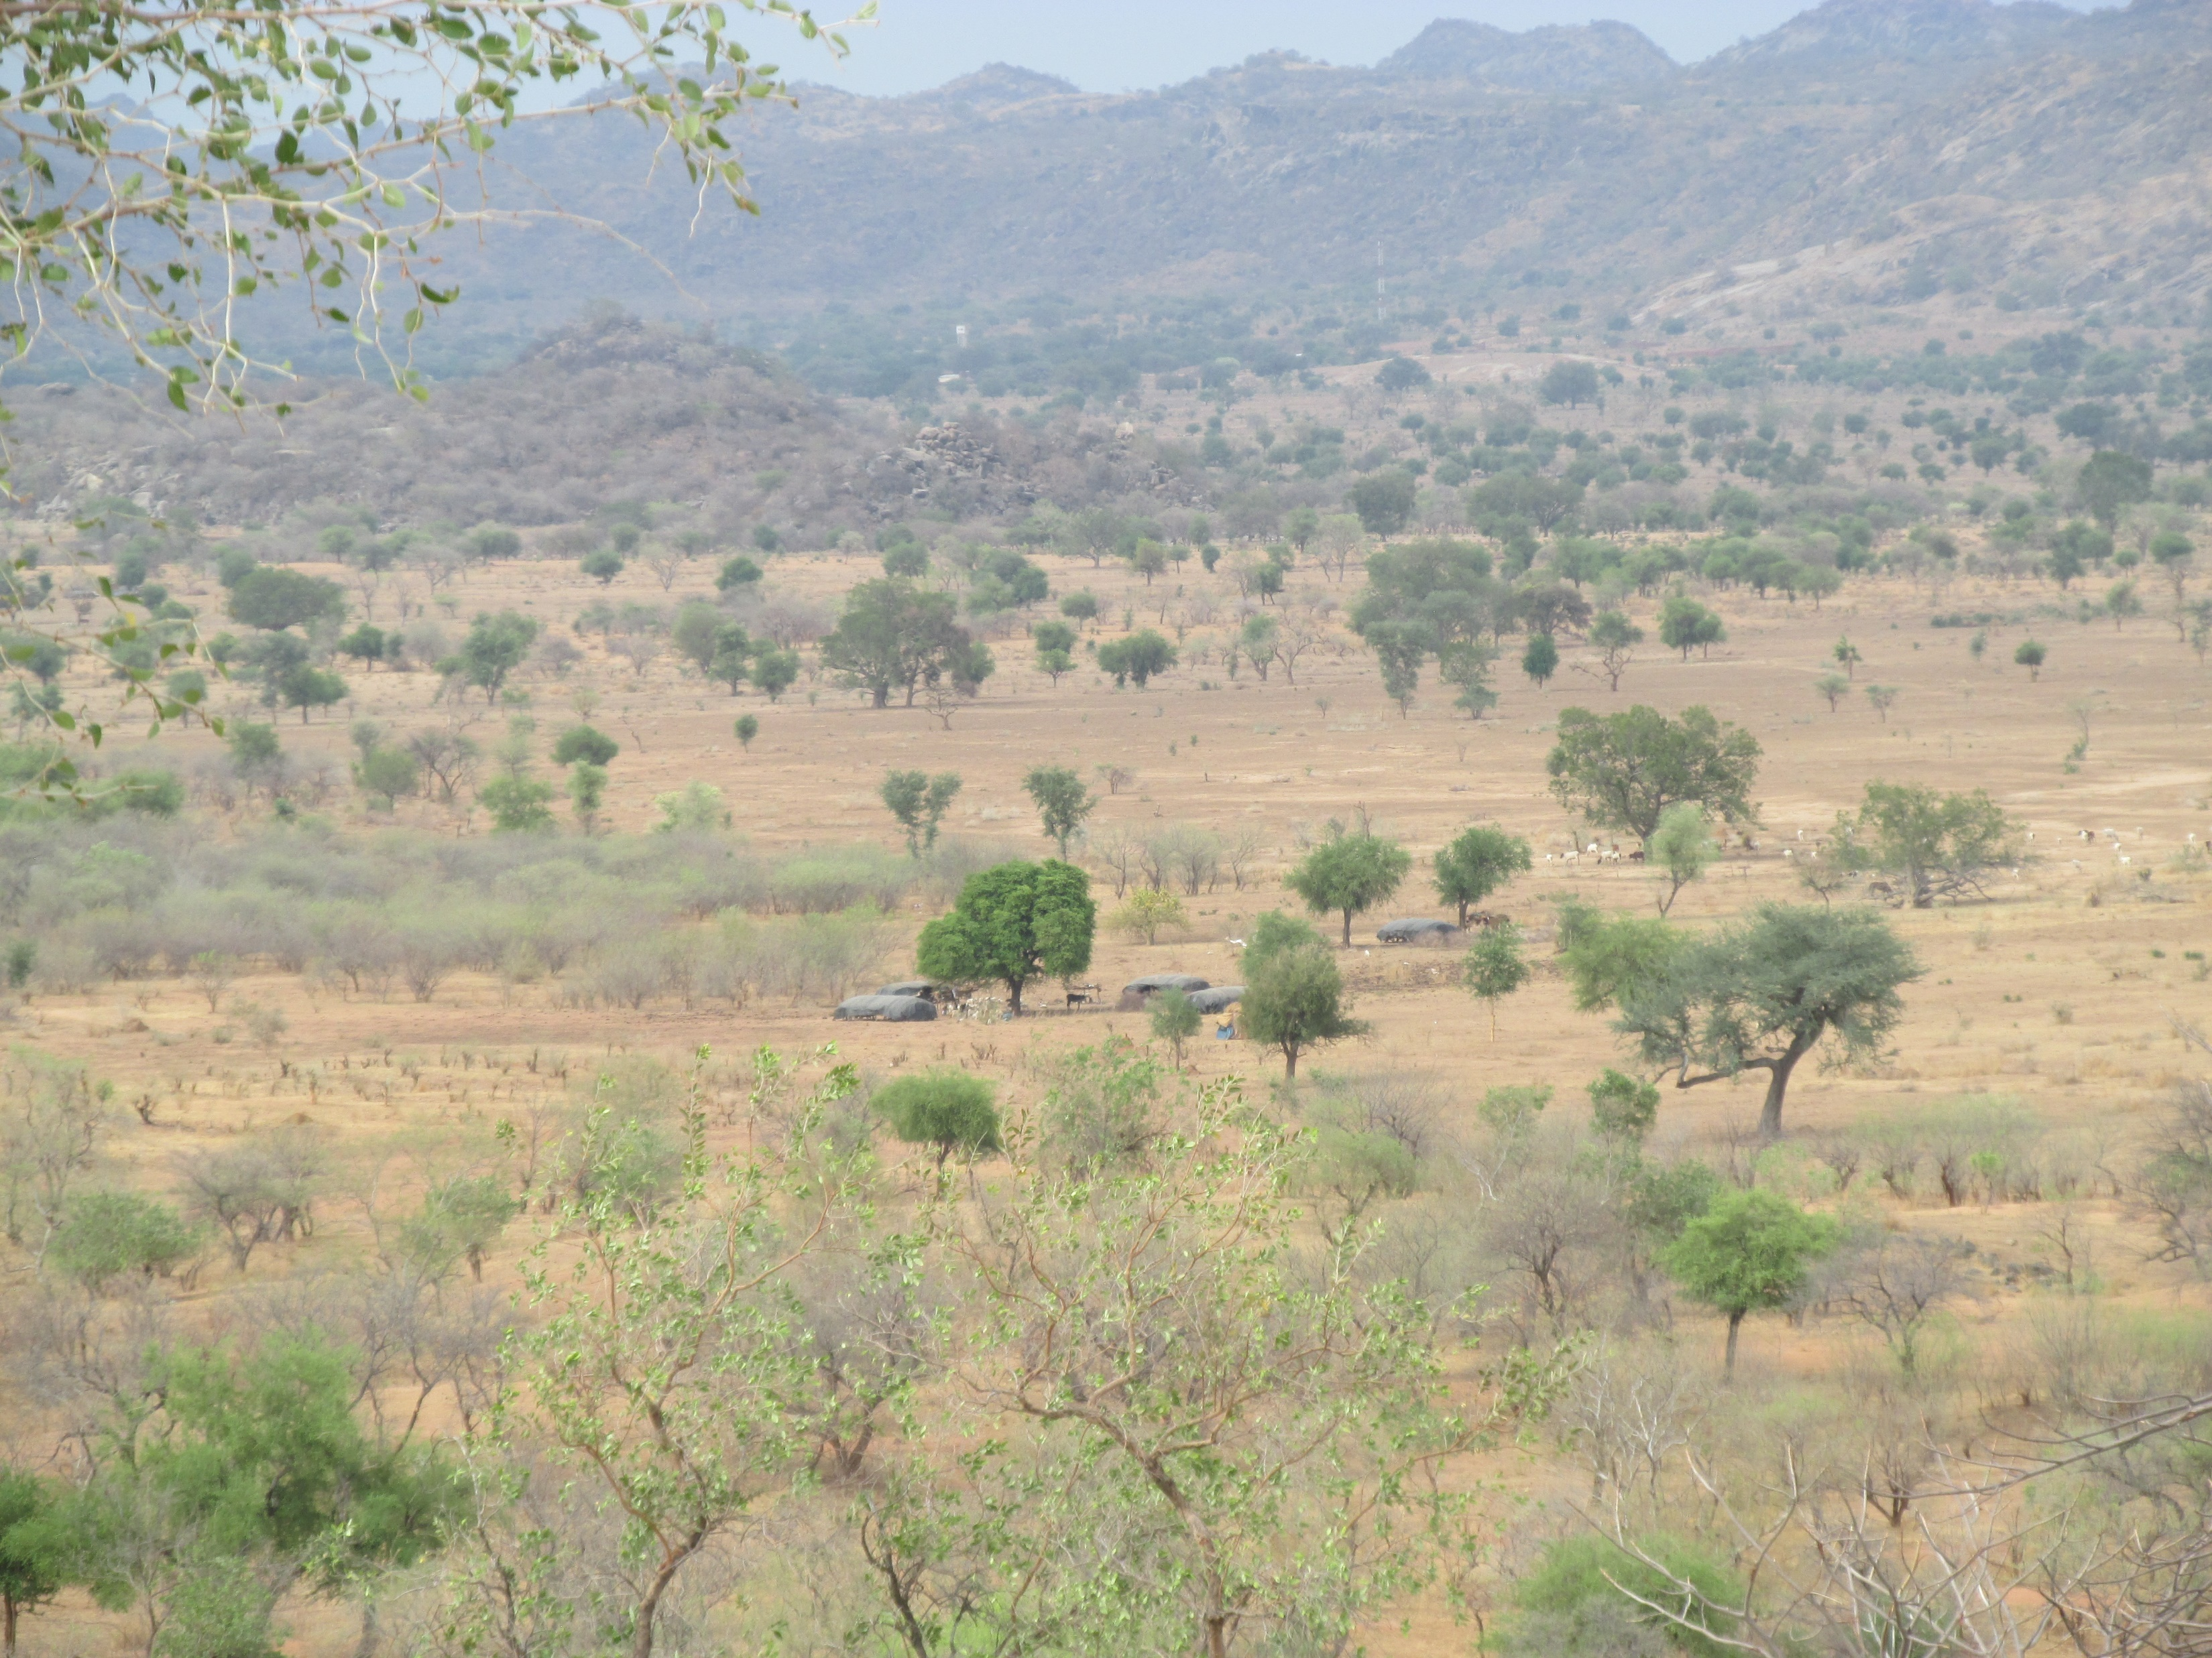
The province of Guéra

Slide 6
Hunts, ahalié and rebellions: Guéra complex past
Widespread narratives remembering what are locally defined as “hunts” – raids - either with the pride of attacking smaller groups or the capacity to resist more powerful attackers
Importance of the narratives of ahalié, local alliances aimed to reinforce protection against raiders and regulating weddings
Colonization (1906) stopped widespread insecurity due to raids, but brought new forms of violence
Competition for state recognition crystalized some narratives and created contradictions and divisions
Displacements due to rebellions (1960s – 1980s) overlap with memories of raids and their dynamics

Slide 7
Labels, resources and conflicts in contemporary Guéra
Co-existence of two narratives, that of autochthony (“we are the ones who were here before” - margay) and that of kinship (“we are the ones who have a clear genealogy” – kachimbeyt)
Often mixed: conflicts emerge about specific issues (conquerors or guests? allies or rivals?) and identities tends to overlap with sedentary and nomadic identities, but with many exceptions
Existence of discriminatory labels such as Haddad – “blacksmith” – or Yalnas – “sons of the people” – to exclude some groups from management of resources
There is always a degree of stigma although it mainly impacts on specific issues, such as control of land or political representation

Slide 8
Labels, resources and conflicts in contemporary Guéra
Ahalié are revamped and reassessed according to contemporary politics, especially for access to development resources or recognition of cantons
Overlapping with civil society initiatives and capacity to cut across different groups (Migami, Dadjo, Arabs)
Overlapping of memories of hunt and rebellions used to legitimize contemporary power relations
Focus on capacity to “resist” or to “hunt”
Rebellions used to create new hierarchies inside the cantons (De Bruijn, Van Dijk 2007)
Discourses of strength and violence as only way to deal with the central government and solve local issues

Slide 9
Governance and resources in Guéra and in the Sahel
Contradictory discourse and practices in Chad, but trend of growing competition over the last thirty years
Similar dynamics all over the Sahel described by scholars in connection with neoliberal decentralization policies
Problem is mainly governance, rather than history: neoliberal decentralization fostered competition (Hibou, Mann) in a context where resources have generally been controlled through force (Roitman, Debos, Lombard, Brachet and Scheele)
In Chad, weak central government legitimacy and violence as a common practice often accepted as inevitable

Slide 10
Conclusion
Colonial and postcolonial policies created a fragmented form of governance that foster competition for resources through identities
Labels and identities are important because enable access to resources
Neither colonial nor postcolonial governments replaced use of force and threat of violence as the main tool of governance
Hunts of the past as well as contemporary acts of violence perceived as legitimate because of the lack of a more powerful and neutral actor

Slide 11
Conclusion
Categories often used to analyse divisions and violence in Chad (northerners vs southerners, herders vs farmers, nomadic vs sedentary) are more political than analytic tools
There are a variety of dynamics that can develop in different directions, divisions are an outcome of a specific strategy implemented by the central government

Slide 12
Thank you for your attention!
Merci pour votre aimable attention!

