Slide 1
From Chibok Girls to Kankara Boys: An Overview of Parameters Surrounding the Kidnapping of Kankara School Children in Southern Katsina Emirate 1987-2019
Ibrahim Sani Kankara Ph.D ibskankara@gmail.com

Slide 2
Introduction
The focus of this paper is on the contemporary security challenge affecting the North western states of Katsina, Zamfara, Kaduna and Sokoto states. The security challenge of Kidnapping and Cattle rustling permutated by the arm Fulani bandits and other like mind criminals in the forest areas of these states could best be understood from the historical context of the arm conflict that exists in the area.
Historically, conflict is a universal phenomenon that evolves in various magnitudes. The interest of conflict actors at all levels is seldom in tandem with one another, even in the presence of interdependency and common goal. Apparently, scarce natural resources create competitive social arrangement which often trigger animosity among people of divergent cultures and even those with common cultural traits

Slide 3
Intro Cont.
It is in the light of the foregoing this paper evaluates how the Boko Haram insurgency changed the pattern of conflict between the farmers and pastoralist to full scale arm banditry and kidnappings in schools of North-western regions of Nigeria. To achieved that this paper evaluates.
One the geography and socio-demograhic setting of Katsina.
Two The Phases of Farmer Pastoralist Conflicts and the Boko Haram insurgency and its impact on Katsina before the 2020 Kankara school children kidnaping.
Three the Kidnapping of the School children and the aftermath.
Fourth the parameters that influence conflict over years.

Slide 4
Geography and Social Demographic Setting of Katsina
Katsina is one the 36 federating states of Nigeria that is located in the extreme Northern part of the country. The state is bounded by Niger Republic to the north, Jigawa and Kano States to the east, Kaduna State to the south and Zamfara State to the west
The population of the state constitutes mainly of Hausa and Fulani ethnics with small number of other ethnic groups such as Igbo, Tiv, Kanuri and Yoruba.
Historically, Katsina state represents the origin of Hausa political aristocracy. The area comprises two ancient kingdoms of Katsina and Daura, respectively.
The predominant occupation of the inhabitant of Katsina is farming and Pastoralism, which were been undoubtedly practiced for centuries.

Slide 5
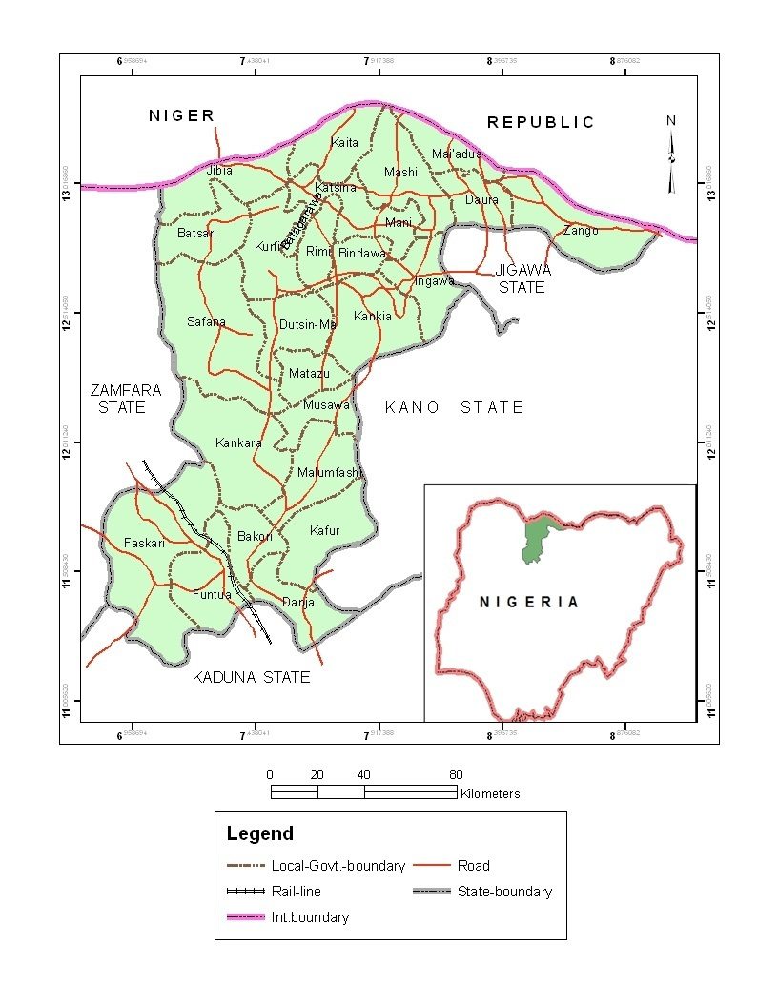
Katsina State Showing the Major Settlements

Slide 6
The Phases of Farmer Pastoralist Conflicts and Boko Haram Insurgence in Katsina Before 2020
The farmer-pastoralists conflicts in Katsina is an essentially economic conflict, irrespective of the religious, cultural and political colorations (Abbass, 2012:191). The conflict is related to population and growth and environmental degradations.
Although, Fulani pastoralist and farmers have long coexisted in symbiotic relationships that have persisted through both peaceful and contentious encounters, reports of violent clashes between these two groups are becoming more frequent in the recent Nigerian History.
In Katsina to be specific the areas greatly affected by this conflict as indicated above are Local governments bordering Zamfara state where the conflict has persisted for many years. The Zamfara-Katsina border area is dotted with chain stony hills that allows the Bandits to maneuver and operate easily.

Slide 7
The Phases of Farmer Pastoralist Cont.
Thus, arm conflict between the farmer and herders men in Katsina can be categorized into three broad phases;
The first phase was between 1979-1999 it covers arm conflict between the herdsmen and farmers during the Harvesting seasons and formation of vigilante groups 1980-1999. The conflict during the period only affects the Fulani herders grazing their cattle’s and farmers whose farmlands are trespass by the herdsmen.
The second phase of the conflict was between 1999-2015, the arm conflicts during this particular period involves conflicts during Harvesting seasons rustling of cows and other domestic animals. Rustling of cattle in the night as well as broad day light arm robbery perpetuated by the Fulani herdsmen. Attack on Fulani settlements and other extra judicial activities by vigilante members and community security volunteer members.
Third phase covers the period 2015 to date. This period was characterized by seasonal conflicts between the Fulani pastoralist and famers, full scale war between the vigilante and herdsmen, kidnapping of commuters and school children incessant attacks on villages.

Slide 8
The Phases of Farmer Pastoralist Cont.
The Boko Haram crisis is considered by many people as one such crisis that threatens the general security of the country. The turmoil has basis from the 2009 clash between the members of the group and the security forces that ended with extra-judicial killing of their leader and other members by the Nigerian security agencies, particularly the police and State Security.
Thus, from the beginning of Boko Haram insurgency Katsina state have its own share of the conflict only when in June 20, 2011 members of the sect attack Kankara LGA divisional police station and Bank PHB branch in the area. Seven people including five policemen killed in gun and bomb attacks on a police station and a bank in Kankara, Katsina State.

Slide 9
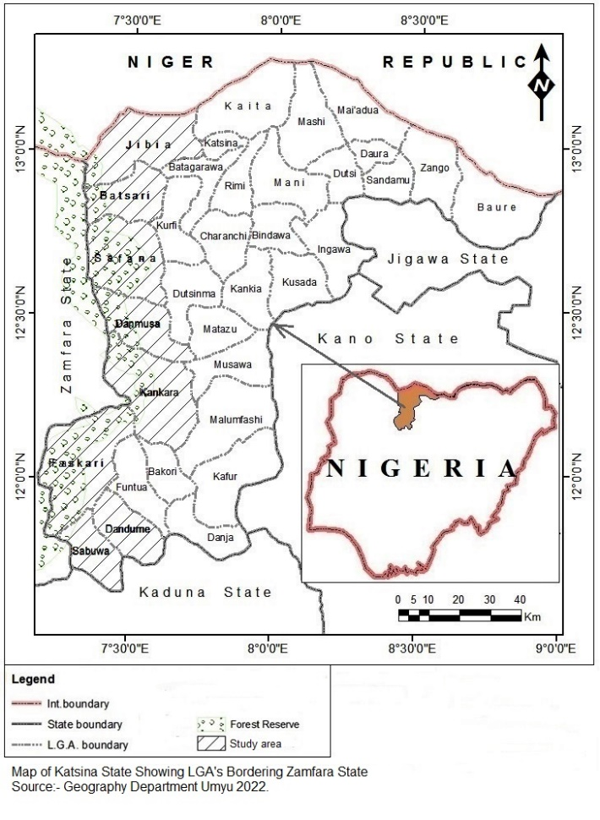
Map of Katsina State Showing the Areas affected by the Fulani Bandits Conflict

Slide 10
The School Boys Kidnapping and Aftermath
Hundreds of fulani gunmen riding on motorbikes stormed the boarding school at night and 300 of the school children were taken away.
During the attack some the boys jumped over a fence and ran away when they heard gunshots. The 300 were rounded up and herded them into the forest the stony hills of Pauwa and Zango. These children were beaten, threatened and forced to walk through the night for 8 Kilometers before they were loaded on motorbikes.
They were dropped at foot of the stony hills that bordered Katsina and Zamfara states. From the border areas they were herded again for another 50 kilometers into Zamfara forest to a place called Marar Katsinawa

Slide 11
The School Boys Kidnapping Cont.
For years the areas around Kankara and other communities neighboring Zamfara had witness constant raid by the Fulani Bandits. These raids were often accompanied by killings and abduction of women, children and other wealthy individuals for the sake of ransom payment. This development gave the farmers conflict a new outlook signaling the emergence of full-blown banditry in the area.
The herdsmen have systematized their attacks by using motorcycles and sophisticated weapons mostly AK47 gun and RPG’s. Thus, moving away from the use of sticks, bow and arrow and other traditional weapons.

Slide 12
The School Boys Kidnapping Cont.
The kidnapping of the children and the subsequent video display by the Bandits signaled a strong connection and attempt by the Boko Haram insurgents to influence the activities of the Bandits in the area.
The children were displayed in a video same as the Chibok Girls were displayed by the Boko Haram insurgents in 2014 by their abductors.
Bandits sent a video clip to the state authorities declaring their allegiance with the Boko Haram group. This development was further confirm by Abubakar Shekau’s video clip claiming that they have mastermind the kidnappings.

Slide 13
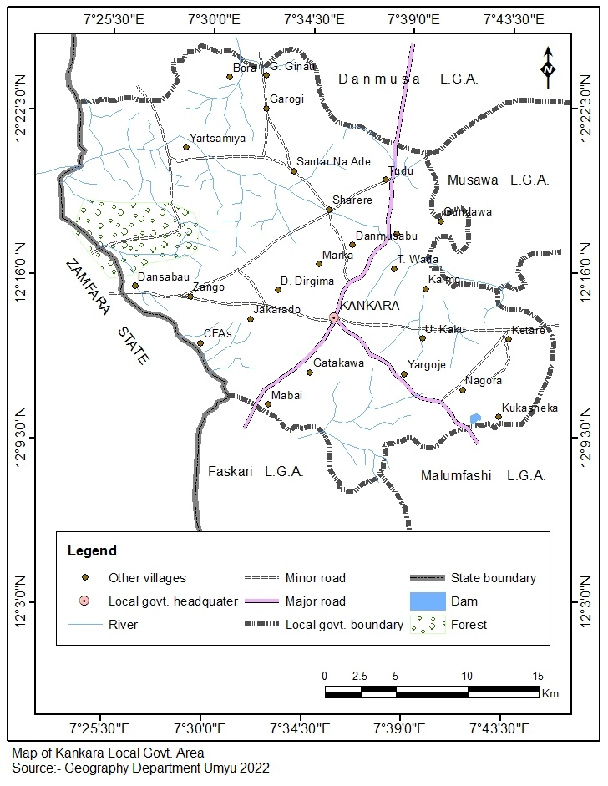
Map of Kankara showing the route through which the boys where herded

Slide 14
The School Boys Kidnapping Cont.
The state responded by dispatching of troops both the military, police and state services to block all routes leading to the area. After series of negotiation the school children were release four days after their abduction.
There were no clear details on the terms of the negotiations before the release of the children by the Fulani Bandits, but many are of the view that money most have exchange hands between the government officials and the mediators.

Slide 15
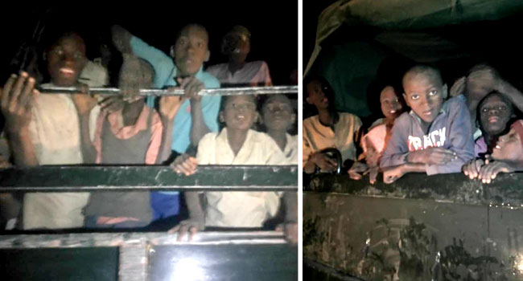
Fig 3. Kankara School Children Inside Military Vans the Night They were Released

Slide 16
Many experts argued that the ransom paid by the authorities for the release of the children greatly assist the bandits in acquiring more sophisticated weapons and other related equipment’s which really helped the groups in expanding their activities across the region.
This was confirmed by the intensity of attacks on farmsteads, villages, schools and government infrastructures. Equally this had open up more kidnappings across the north-western states.
The attacks on villages and schools in particular became so rampant across the states of Kaduna Zamfara, Kebbi and Niger states

Slide 17
Incidence of Attacks on Schools Across North-West After Kankara Incident April 2014 - May 2021
S/N | VICTIMS | NUMBER ABDUCTED | CASUALITIES | Year /Month | STATE
1 | Governments Girls Secondary School Chibok | 276 |  | April 2014 | Borno
2 | Government Girls Science Technical Dapchi | 110 | 1 | 19 February 2018 | Yobe
3 | Government Science Secondary School Kankara | 300 |  | 11 December 2020 | Katsina
4 | Governments Girls Secondary School Kagara | 270 | 1 | 17 February 2021 | Niger
 | Governments Girls Secondary Jengebe | 319 | 1 Police Officer was killed | 26 February 2021 | Zamfara
5 | Greenfield University, Kaduna | unknown number | 1 Security Personnel Killed | 21 April 2021 | Kaduna
6 | Islamiyya School Tegina | 200 |  | 29 May 2021 | Niger

Slide 18
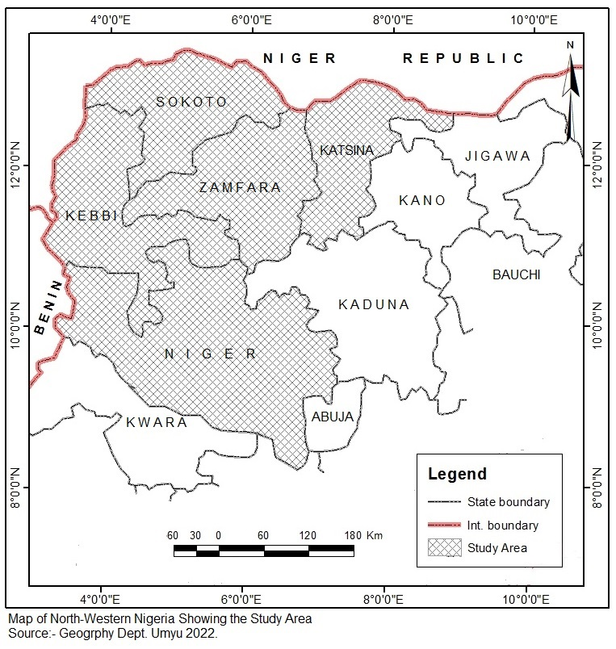
States Affected by Bandits Abduction of School Children

Slide 19
Other the Parameters of the Conflict
Excesses of Vigilante groups- Vigilante groups that were assigned by the local communities to be in charge of security or assist the security agents abuse the assignment given to them which resulted that harsh punishments were meted to offenders and their relations particularly the Fulani who then regroup to retaliate on the vigilante and the local communities in the State.
Mining activities- This has fuelled the insecurity situation as the forest areas of Katsina and Zamfara States contains many mineral resources such as alluvial gold, copper, feldspar, manganese and some rare earth minerals which Nigerians are not aware of their existence. The Miners and their collaborators are creating the banditry so that they continue to harvest the minerals without the local community’s awareness.

Slide 20
Other the Parameters Cont.
Unemployment-The high rate of unemployment that has persisted over the years in Nigeria have created large number of people who can engaged in criminal activities for money such as highway armed robbery then cattle rustling and presently the kidnapping of people for ransom. The abuse of drugs by some of the youths have further aggravated the situation making the kidnapping and armed banditry merciless and deadly
Injustice-Fulani claim of injustice in certain situations when their cattle are taken away and claiming that the cattle are stolen cattle. Then in order to regain their cattle they began to kidnap people and threatening that those kidnapped will only be returned in exchange for their cattle. In situations where they could not regain their lost cattle they conceive the idea of kidnapping people particularly those that are wealthy and well to do to collect the ransom and use it to buy cattle and start cattle rearing once again.

Slide 21
Other the Parameters Cont.
Technological Advancements: Present day technological advancements such as the use of online banking, automated teller machines ,credit cards and others means that does not require travelers to carry money make criminals to engage in kidnapping. They kidnap people and then requests that some sums of money should be given to them in order to return the kidnapped person safely to join his/her family and friends. The use of GSM phone is another example of technological advancement that has given rise to kidnapping as the Kidnappers relay a lot on communications with the phone to inform relatives of victims on the kidnap and to negotiate and collect the ransom.

Slide 22
Other the Parameters Cont.
Collapse of Rural Infrastuructures
Equally the collapse of agricultural infrastructures such as Schools, Roads Dams, grazing reserves and farm service centers can be viewed as another major parameter that stimulate the conflict in the area especially during the dry season.

Slide 23
Conclusion
Kidnapping of Chibok school girls in 2014 by the Boko Haram presented a new chapter in the history of conflict in Nigeria. The idea of kidnapping of Kankara school boys can be seen as part effort by the Fulani bandits to extend the Boko Haram influence in the North Western region of Nigeria. The release of the Kankara boys after negotiation fueled abductions of more school children in the region. The kidnapping has a serious socio-economic and political effects communities affected by the conflict. Thus, to understand the kidnapping of Kankara school boys one needs to underscore the socio-economic and political parameters of the conflict

